Slide 1
Enhance Application Security Capabilities
CompTIA Security+ Exam SY0-701
Lesson 11

Slide 2
Application Protocol Security Baselines
Lesson 11
Topic 11A

Slide 3
Secure Protocols
Many of the protocols used today were developed many decades ago
  Functionality was primary focus
  Trustworthiness was assumed
  Cybersecurity was less of an issue than it is today
Insecure Protocols
  Transmit data in clear text format
  Generally, cannot be secured
  Must be avoided
Secure Protocols
  Same functionality and secure
  More complex to configure
Insecure | Secure Alternative
Telnet | SSH
HTTP | HTTPS
FTP | FTPS/SFTP

Slide 4
Transport Layer Security
Most Common Uses
  Secure HTTP communications
  Virtual Private Networking (VPN)
SSL/TLS Versions
  SSL 2.0, 3.0
  TLS 1.0, 1.1, 1.2, 1.3
  Only use TLS version 1.2 or newer
  Disable all others
    Downgrade attack
Notes:
This Cloudflare blog provides an excellent overview of the problems with earlier TLS versions for students who want more detail: blog.cloudflare.com/rfc-8446-aka-tls-1-3

Slide 5
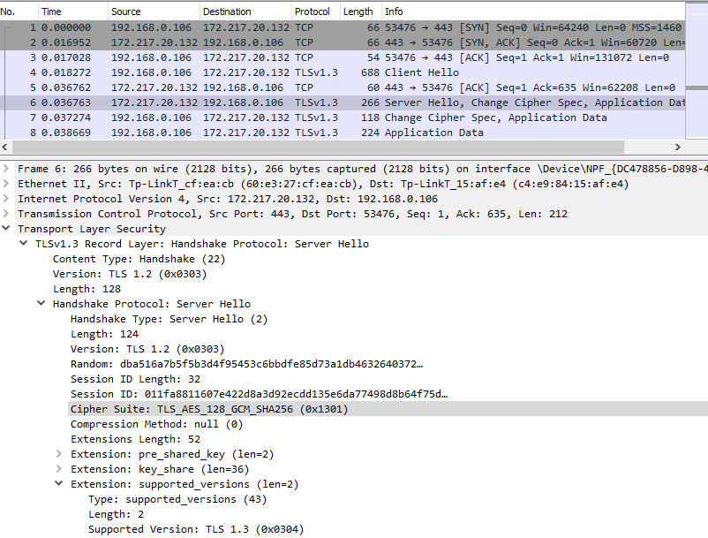
Transport Layer Security
Cipher Suites
  Describe the mix of algorithms used to implement TLS protections
Prior to TLS 1.3
  ECDHE-RSA-AES128-GCM-SHA256
TLS 1.3 uses shortened suites
  TLS_AES_256_GCM_SHA384
Only lists bulk encryption key strength, mode of operation and hash type
Viewing the TLS handshake in a Wireshark packet capture. Note that the connection is using TLS 1.3 and one of the shortened cipher suites (TLS_AES_128_GCM_SHA256).
Notes:
Students may question why the version field reads TLS 1.2. This field is prone to a compatibility problem when servers cannot identify a new version. As a workaround, servers supporting TLS 1.3 should use the supported_versions extension instead.

Slide 6
Secure Directory Services
A Network directory contains
  Subjects (users, computers, and services)
  Objects (directories and files) available in the environment
  Permissions that subjects have over objects
  High-value attack target
Lightweight Directory Access Protocol (LDAP)
  Default is cleartext communication
Notes:
Using TLS as part of SASL (STARTTLS) is referred to as opportunistic encryption.

Slide 7
Simple Network Management Protocol Security
Simple Network Management Protocol (SNMP)
Management and monitoring
SNMP monitor + agents
Provides very detailed information about systems
Uses “Community Strings” default “Public” and “Private”
Can be used to issue commands
SNMPv3 has secure features, other versions should be avoided
Notes:
SNMP is one of those services that should be shut down if it is not being used. SNMP may run on devices such as switches, firewalls, and printers.

Slide 8
File Transfer Services
File Transfer Protocol
  Cleartext
  Used to host and share files
SSH
  Primarily used to access a shell remotely
  Very versatile protocol
  Can be used as a tunnel for other protocols
FTP (SFTP) and FTP Over SSL (FTPS)
  SFTP is FTP tunneled through SSH
  FTPS is FTP secured using TLS
Notes:
Make sure students know the differences among FTP, FTPS, and SFTP, including which ports are associated with which variant.

Slide 9
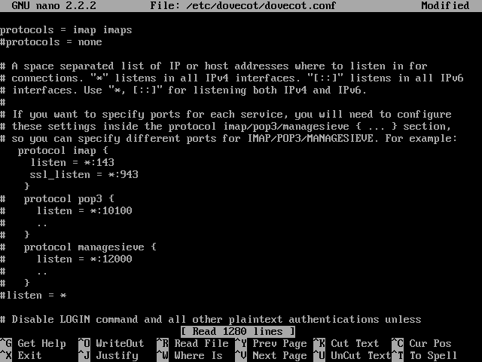
Email Services
SMTP
  Cleartext by default
  Transmit email between systems
  SMTPS is secure configuration
Open Relay
  Improperly configured SMTP server
  Used to send SPAM
POP & IMAP
  Used to access mailboxes
  Cleartext by default
  POPS & IMAPS are secure
Configuring mailbox access protocols on a server.
Notes:
Make sure students understand the difference between mail transfer and mailbox access.

Slide 10
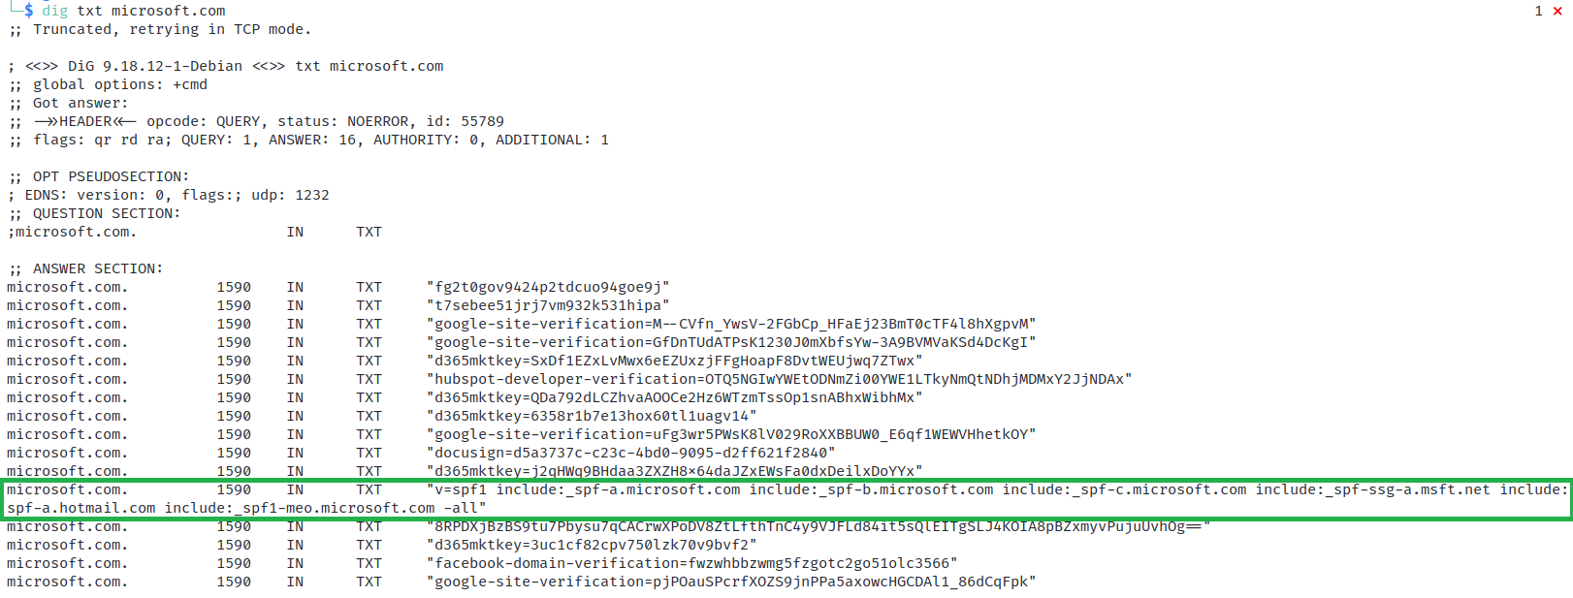
Email Security
Sender Policy Framework (SPF)
  Email validation method that helps detect and prevent sender address forgery
  Uses data saved in DNS TXT Records
  Can use to identify “authorized senders”
    Hosted email
    Marketing campaigns, etc.
Displaying the TXT records for microsoft.com using the dig tool. (Screenshot used with permission from Microsoft.)
Notes:
Stress the difference between providing secure ports for accessing SMTP and mailbox profiles with the use of S/MIME to authenticate senders and encrypt messages.

Slide 11
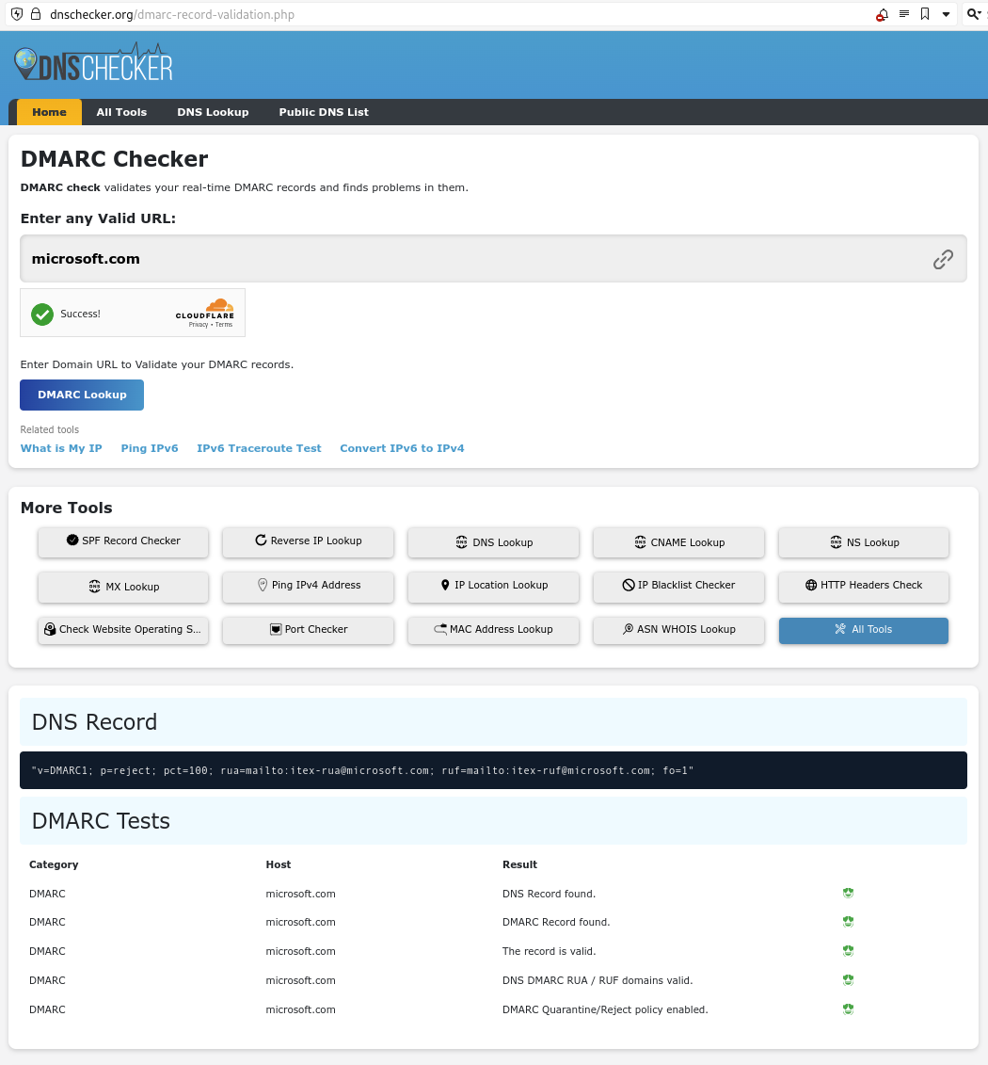
Email Security
DomainKeys Identified Mail (DKIM)
  Sender signs emails using a digital signature
  Receiver uses a DKIM record in the sender's DNS to verify the signature
Domain-based Message Authentication, Reporting & Conformance (DMARC)
  Uses the results of SPF and DKIM checks to define rules for handling messages
  Provides reporting capabilities
    Email activity
    Identify systems sending emails
    Identify unauthorized activity
Performing a DMARC lookup using the DNSChecker website https://dnschecker.org.

Slide 12
Email Security
Email Gateway
  Control point for all incoming and outgoing email
  Anti-spam filters and antivirus scanners
  Sophisticated threat detection algorithms
    Identify phishing attempts, Business Email Compromise (BEC) Attack
  Harmful attachments and malicious URLs
    URL Sanitization/Link Anonymization/Safe Linking/Web Link Transformation
Secure/Multipurpose Internet Mail Extensions (S/MIME)
  Encrypts emails to provide the confidentiality and integrity protections
  Requires Public Key Infrastructure (PKI)
Notes:
You might also want to mention policy-based encryption. This requires the use of S/MIME if there are matches to keywords in a certain message.

Slide 13
Email Data Loss Prevention
Email is one of the most frequently used communication channels within organizations
  Conduit for sensitive data
  Encourages careless handling of sensitive data (ease of use) and prone to human error
  Common channel for data loss
  GDPR, HIPAA, and PCI DSS, (and others) have requirements for protecting data
DLP scans emails and attachments for certain types of sensitive information
  Prevents unauthorized sharing of sensitive information
  Create organization-wide DLP policies
  Actions are based on predefined rules, such as
    Blocking the email, alerting the sender, automatically encrypting it

Slide 14
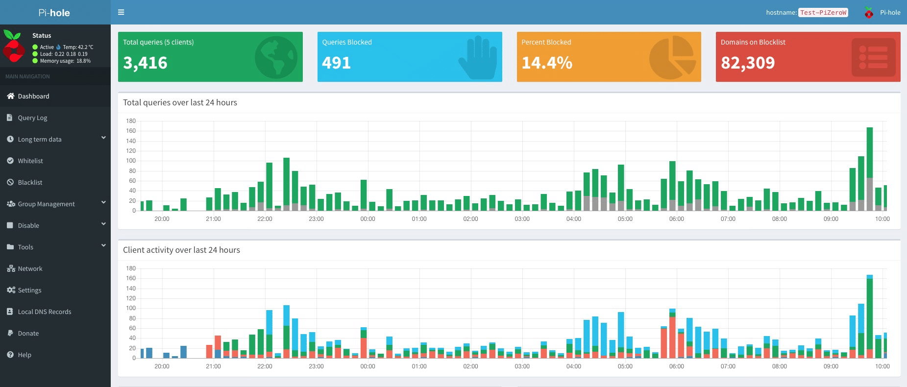
DNS Filtering
Block or allow access to specific websites
  DNS filter checks requests against a database of domain names
  Block access to malicious sites
  Content/Site Restrictions
  Ad-blocking (Pi-Hole, AdGuard)
OpenDNS opendns.com
Quad9 quad9.net
CleanBrowsing cleanbrowsing.org
Cisco Umbrella umbrella.cisco.com/products/dns-layer-network-security
CloudFlare DNS cloudflare.com/application-services/products/dns/
The Pi-hole administrative dashboard showing DNS resolution statistics. (Screenshot courtesy of Pi-hole.)

Slide 15
DNS Security
DNS Contains valuable information about hosts on a network
Internal records should not be accessible from the Internet
DNS protocol is often exploited to perform data exfiltration
DNS can be exploited to provide malicious data (ex. Attacker IP instead of real IP)
DNS Security Extensions (DNSSEC)
  Mitigate spoofing and poisoning attacks
  Provides a validation process for DNS responses
  Authoritative server for the zone creates a "package" of resource records (RRset)
Notes:
The majority of top-level domains (TLDs) and country code TLDs are signed. Otherwise, adoption of DNSSEC is patchy except in the .gov domain. You can refer students to charts about DNSSEC adoption at internetsociety.org/deploy360/dnssec/statistics.

Slide 16
Application Protocol Security Baselines
Secure Protocols
Transport Layer Security
Secure Directory Services
Simple Network Management Protocol Security
File Transfer Services
Email Services
Email Security
Email Data Loss Prevention
DNS Filtering
Notes:
Take some time at the end of each topic to answer questions. You can use the review questions for discussion in class or set them for students to complete individually during or after class.

Slide 17
Assisted Lab: Performing DNS Filtering

Slide 18
Cloud and Web Application Security Concepts
Lesson 11
Topic 11B
Notes:
Having covered the main attack types, this topic looks at coding techniques that mitigate those risks.

Slide 19
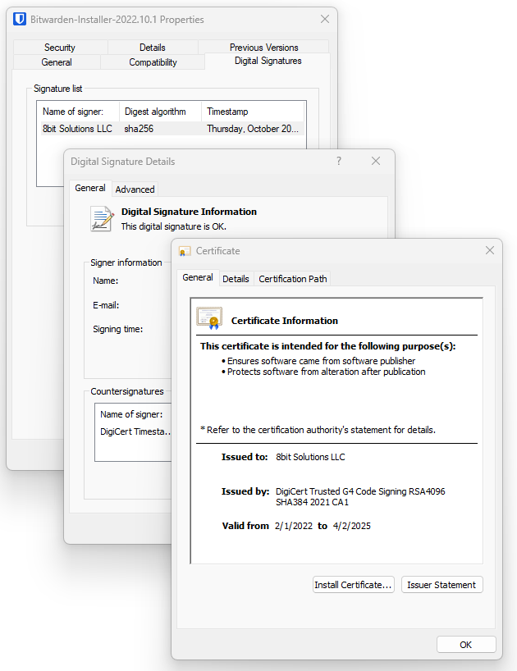
Secure Coding Techniques
Pressure to release an application often overshadows the requirement to ensure it is secure
Coding practices must implement secure development practices
Code Signing
Secure Cookies
Static/Dynamic Code Analysis
Peer Review
Reviewing the digital signature contained within the Bitwarden Password Management app installer.

Slide 20
Secure Coding Techniques
Input Validation
Attacker provides specially crafted data to an application to manipulate its behavior
Injection Attack
Methods used to perform input validation:
  Allow/Block Lists
  Data Type checks
  Range checks
  Regular Expressions
  Encoding
Notes:
OWASP provides an excellent overview of input validation at https://cheatsheetseries.owasp.org/cheatsheets/Input_Validation_Cheat_Sheet.html.

Slide 21
Application Protections
Data exposure
Allows privileged information to be read by unauthorized user
  Access token
  Password
  Personal data
Error Handling
  Safely handle and control errors
  Report errors to logs instead of user interface
Application Security in the Cloud
  Application security supports the shared responsibility model
  Secure applications running on a secure cloud platform

Slide 22
Application Protections
Memory Management
  Buffer overflow attacks are a decades-old problem
  Input validation is an important defense
Client-Side vs. Server-Side Validation
  Security checks should be performed server-side
  Developers often use client-side checks to improve application performance
  Client-side checks can be bypassed

Slide 23
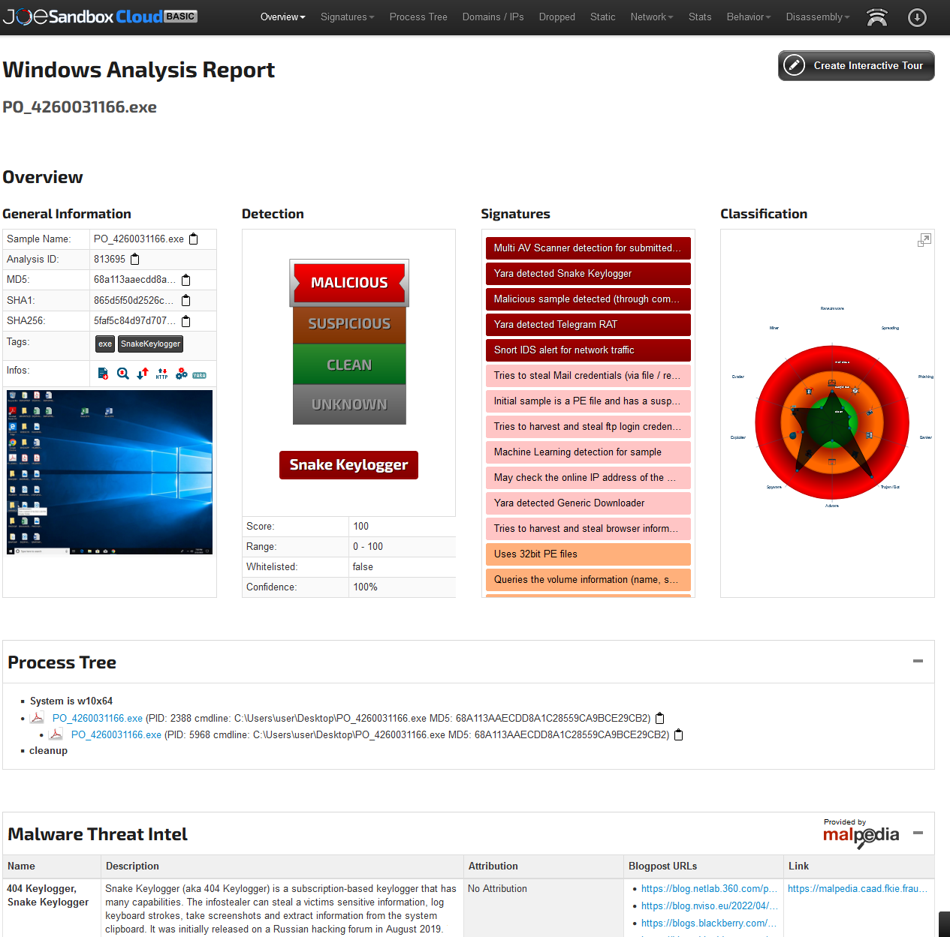
Software Sandboxing
A security mechanism used to isolate software
Prevent it from accessing operating system features
Isolate is from other processes/software
Prevent access to network
“Safe Detonation”
Joe Sandbox analysis of a malicious executable file. (Screenshot courtesy of Joe Security, LLC.)

Slide 24
Secure Coding Techniques
Application Protections
Software Sandboxing
Notes:
Take some time at the end of each topic to answer questions. You can use the review questions for discussion in class or set them for students to complete individually during or after class.

Slide 25
Assisted Lab: Configuring System Monitoring

Slide 26
Summary
CompTIA Security+ Exam SY0-701
Lesson 11

